Slide 1
Clustering & PCA Assignment
Ram Dittakavi
dittakaviram@gmail.com

Slide 2
Problem Statement
HELP International (NGO) needs to decide how to use the fund ($ 10 million) which it raised recently, strategically and effectively to aid the people of backward countries with basic amenities and relief during the time of disasters and natural calamities.
Given the data of various countries and their socio-economic and health factors, the goal is to form various groups of countries with similar properties and then take a decision on which group to focus on.

Slide 3
Approach
Since this is a classic clustering problem in the Data Analysis terminology, we employ two different Clustering Machine Learning Algorithms to form the clusters or groups.
We will look at different statistical techniques to select the number of groups and finally apply the algorithms to obtain the clusters.
We finally analyze the clusters against various socio-economic and health factors of the countries that are part of each cluster and evaluate the performance of the algorithm.

Slide 4
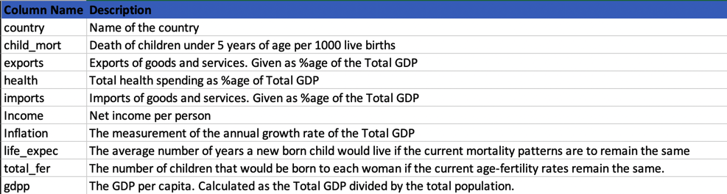
Socio-Economic/Health Factors
Below are the factors of each country provided as part of the data set:

Slide 5
Principal Component Analysis

Slide 6
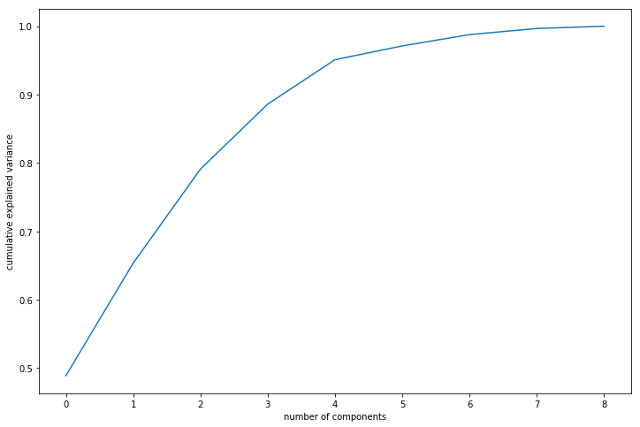
Choice of Components
We used Principal Component Analysis to come up with a subset of components or variables that help us explain all the info(variance) in the data. We selected 5 components based on the below Screen Plot since they can explain more than 95% of variance:

Slide 7
Hopkins Statistic
Hopkins Statistic helps us understand if the data provided has a tendency to be grouped into clusters.
A value of more 0.7 for this metric confirms the cluster tendency and obtained 0.73 for the same with our data set:

Slide 8
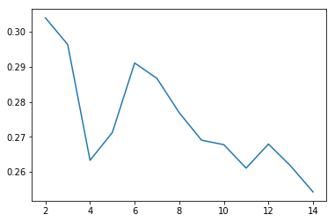
Silhouette Analysis
Silhouette coefficient is a measure of how similar a data point is to its own cluster (cohesion) compared to other clusters (separation).
An optimal K gives clusters that are cohesive with respect to the elements inside each of them and dissimilar with the others.
From the analysis we could say that clusters 3 and 6 make more sense:

Slide 9
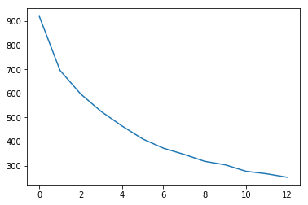
Sum of Squared Distances
SSD helps in determining the optimal clusters by plotting the inertia against each cluster number choice.
Inertia represents how tightly different clusters are formed. We decided to consider 3 and 6 clusters based on the below elbow curve:

Slide 10
Hierarchical Clustering

Slide 11
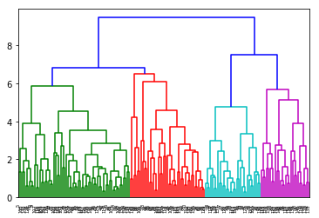
Choice of Clusters
From the below o/p of Hierarchical Clustering, we clearly see that the data set is forming into 4 different clusters or groups:

Slide 12
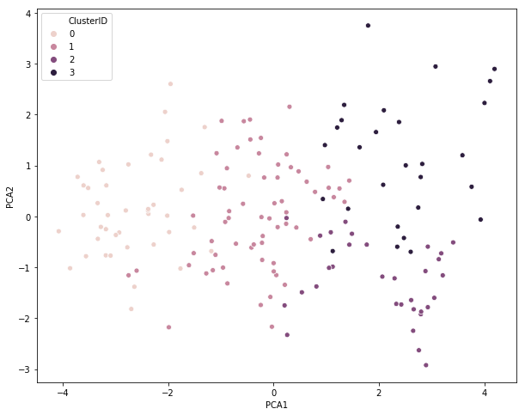
Visualizing PC on Clusters
When we plot PCs (2) on the obtained clusters, we don’t see formation of tight groups and intuitively it tells this is not the best way to cluster the data.

Slide 13
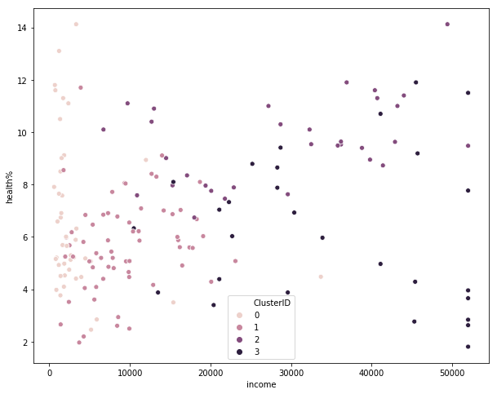
Visualizing Original Variables on Clusters
When we plot Income and Health% on the obtained clusters, we don’t see formation of tight groups and intuitively it tells this is not the best way to cluster the data.

Slide 14
K Means (K=6)

Slide 15
Choice of K
Since Hierarchical clustering didn’t visually show promising clusters in the data, we decide to go with the analysis output of SSD and Elbow curve.
We will first analyze the output of K Means with K = 6 and then compare the analysis with K =4.

Slide 16
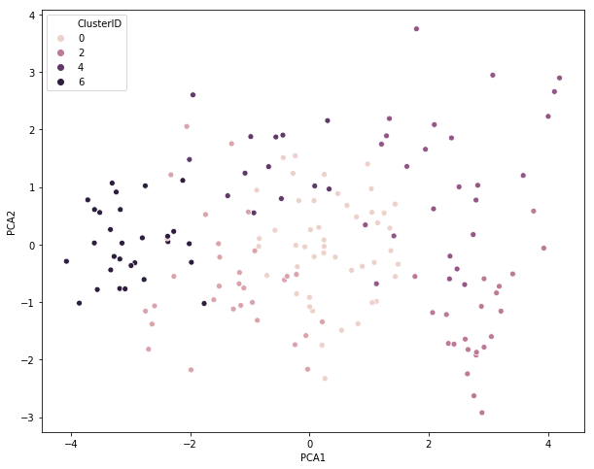
Visualizing PC on Clusters
When we plot PCs (2) on the obtained clusters, we don’t see formation of tight groups and intuitively it tells this is not the best way to cluster the data.

Slide 17
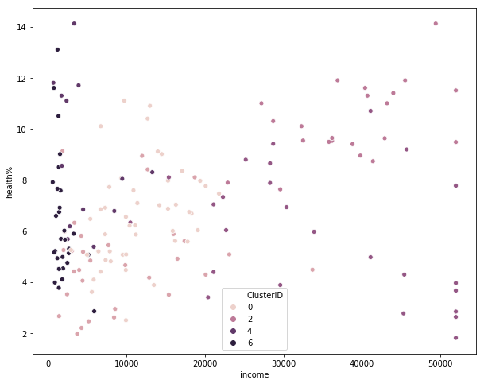
Visualizing Original Variables on Clusters
When we plot Income and Health% on the obtained clusters, we don’t see formation of tight groups and intuitively it tells this is not the best way to cluster the data.

Slide 18
K Means (K=3)

Slide 19
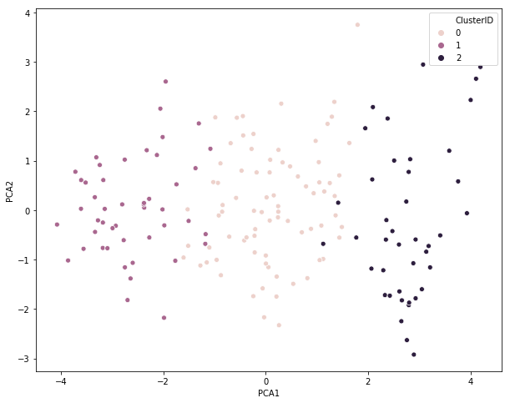
Visualizing PC on Clusters
We can see a natural formation of clusters with K = 3 with the below properties:

Slide 20
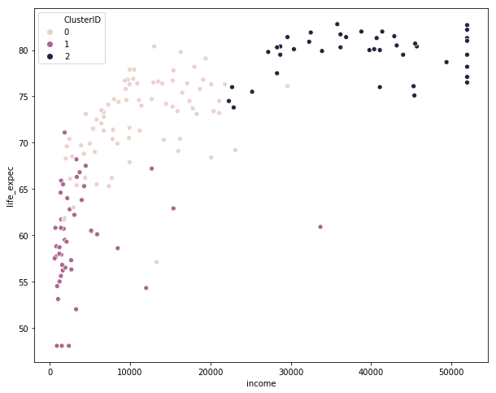
Visualizing Original Variables on Clusters
We can see a natural formation of clusters with K = 3 with the below properties:

Slide 21
Summary
As we can clearly see, K = 3 yields better results compared to K = 6. Below is the list of countries that HELP should focus on for providing the aid as these have less income and low to medium life expectancy which are one of the important health and socio-economic factors that need to be considered:
Afghanistan, Angola, Benin, Burkina Faso, Burundi, Cameroon, Central African Republic, Chad, Comoros, Congo, Dem. Rep., Congo, Rep., Cote d'Ivoire,
Equatorial Guinea, Eritrea, Gabon, Gambia, Ghana, Guinea, Guinea-Bissau, Haiti, Iraq, Kenya, Kiribati, Lao, Lesotho, Liberia, Madagascar, Malawi, Mali,
Mauritania, Mozambique, Myanmar, Namibia, Niger, Nigeria, Pakistan, Rwanda, Senegal, Sierra Leone, South Africa, Sudan, Tanzania, Timor-Leste,
Togo, Uganda, Yemen, Zambia

